Slide 1
Small
Talk
Mastery
Next

Slide 2
Small
Talk
Mastery
“Every great romance and each big business deal begins with small talk.
The key to successful small talk is learning how to connect with others, not just communicate with them.”
-Bernardo J. Carducci
Back
Next

Slide 3
Introduction
Small
Talk
Mastery
Imagine you have just received a call from a customer. As you are waiting for the computer to pull up the customer’s account you find that the system is very slow. You notice an awkward silence on the line as you can hear the customer breathing and no words are being exchanged. What do you do to fill the time? Make small talk!
Welcome to Small Talk Mastery! This training is designed to help you become proficient at connecting with customers on a personal level. In this module you will explore guidelines to help you enhance your small talk skillset, watch videos and read article on making small talk, and assess your understanding of this vital topic.
Back
Next

Slide 4
Introduction
Small
Talk
Mastery
To be a master conversationalist there are a few guidelines to follow to ensure you and your customer have a pleasant interaction in which you can meet their needs and wow them with your conversational prowess.
Training Objectives:
Identify techniques involved in making small talk
Apply methods for enhancing small talk
Explore learning resources to understand small talk
Back
Next

Slide 5
Table of Contents
Small
Talk
Mastery
Small Talk Techniques
Become Audience Focused
Ask Strategic Questions
Build a Repertoire of Topics
Engage and Connect
Learn from the Best
Learning Resources
9 Ways to Get Better at Small Talk
How to Make Small Talk
Six Reasons Small Talk is Very Important
Tips to Master the Art of Small Talk in Business
Back
Next

Slide 6
Small Talk Techniques
Small Talk Techniques
Become Audience Focused
Ask Strategic Questions
Create a Topic Repertoire
Engage & Connect
Learn from the Best
Back
Next

Slide 7
Small Talk Techniques
Become Audience Focused
Show Interest
Let Others Talk
Back
Next

Slide 8
Become Audience Focused
The first technique to observe when making small talk with customers is to be audience centered. This means you want to make the person you are speaking with comfortable. The best way to do this is to demonstrate genuine interest in the other person by letting them talk and actively listening.
If you are not familiar with a topic, be honest and ask them to teach you more about it. If you don’t show genuine interest, the other person will know you are going through the motions and not trying to connect with them.
Back
Next

Slide 9
Become Audience Focused
Example:
Your customer begins explaining how they are training for a marathon and you respond with:
“That’s nice. Okay, so your customer account shows…”
Instead, take a moment and ask about the rigors of marathon training before getting down to business. Focusing on what is important to the customer can make all the different to him/her in the interaction.
Back
Next

Slide 10
Small Talk Mastery Check
Small
Talk
Mastery
Mastery Check: Apply your knowledge by selecting true or false.
Question: If there is a subject you are not familiar with, just lie and pretend you are an expert. The customer will never know.
True
False

Slide 11
Small Talk Mastery Check
Small
Talk
Mastery
Mastery Check Answer
Question: If there is a subject you are not familiar with, just lie and pretend you are an expert. The customer will never know.
Answer: You selected True. Oops that is incorrect.
Try again

Slide 12
Small Talk Mastery Check
Small
Talk
Mastery
Mastery Check Answer
Question: If there is a subject you are not familiar with, just lie and pretend you are an expert. The customer will never know.
Correct Answer: False.
When making small talk, be genuine. If you don’t know, use the opportunity to ask them to teach you more about the topic.
Continue

Slide 13
Small Talk Techniques
Ask Strategic Questions
Use Open Ended Questions
Avoid Yes/No Questions
Back
Next

Slide 14
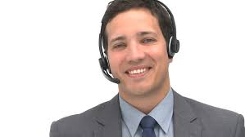
Ask Strategic Questions
The second technique to observe when making small talk with customers is to ask strategic questions. Instead of asking closed questions with yes or no type answers, use questions that allow the customer to choose from a broad spectrum of answers.
Whenever the person you're talking to introduces any new information about themselves, their interests, their preferences... anything at all that you didn't know about them before, pounce on that. See that as a doorway to a new path of conversation, open it and see where it leads. People drop new information about themselves constantly in conversation... it's just a matter of developing an ear for it.
Back
Next

Slide 15
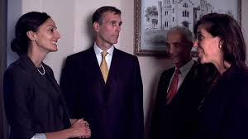
Ask Strategic Questions
Example:
Instead of asking, “What do you do?” instead say, “What's keeping you busy these days?” This allows your conversational partner to choose what he/she focuses on: work, family, or other interests.
Example:
Instead of asking “How long have you been with Owners.com?” Ask an open ended questions, “How did you become involved with owners.com?”
Back
Next

Slide 16
Small Talk Mastery Check
Small
Talk
Mastery
Mastery Check:
Apply your knowledge by selecting true or false.
Question: Instead of asking yes/no questions that lead to dead ends, encourage your conversation partner to share some more detail about what interests him/her.
True
False

Slide 17
Small Talk Mastery Check
Small
Talk
Mastery
Mastery Check Answer
Question: Instead of asking yes/no questions that lead to dead ends, encourage your conversation partner to share some more detail about what interests him/her.
Answer: True - Yes that is correct! Open ended questions can inspire further topics to discuss.
Continue

Slide 18
Small Talk Mastery Check
Small
Talk
Mastery
Mastery Check Answer
Question: Instead of asking yes/no questions that lead to dead ends, encourage your conversation partner to share some more detail about what interests him/her.
Answer: False – Oops that is wrong. Try again.
Try Again

Slide 19
Small Talk Techniques
Create a Topic Repertoire
Stay Informed
Stick to Safe Topics
Back
Next

Slide 20
Build a Topic List
The third technique to observe when making small talk with customers is to build a topic list by exploring events, trends, and gathering other interesting topics to discuss with customers.
Be sure to stick with safe topics such as: weather, music, television and films, sports, pets, current events and trends. Avoid touching on topics that have opposing viewpoints such as religion or politics. Remember, you are there to converse, not debate. You can also use safe topics to springboard into further small talk and engage the customer.
Back
Next

Slide 21
Build a Topic List
Example:
“So how has the weather been in your area this week?” The customer replies, “It’s been too wet to even walk my dog.”
This would be an good opportunity time to ask more about his/her pet. “Oh, I have a poodle. Tell me about your dog.”
Back
Next

Slide 22
Small Talk Mastery Check
Small
Talk
Mastery
Mastery Check: Apply your knowledge by selecting the correct answer.
Question: Choose the subject(s) that is safe to discuss when making small talk with a customer:
Asking about their health care practices
Inquiring how much money they make each year
Sharing malicious office gossip
Finding out who they voted for in an election
Discussing the weather in their region

Slide 23
Small Talk Mastery Check
Small
Talk
Mastery
Mastery Check Answer
Question: Choose the subject(s) that is safe to discuss when making small talk with a customer you just met:
It’s best to avoid this topic. Try again.
Asking about their health care practices
Select Another

Slide 24
Small Talk Mastery Check
Small
Talk
Mastery
Mastery Check Answer
Question: Choose the subject(s) that is safe to discuss when making small talk with a customer you just met:
It’s best to avoid this topic. Try again.
Inquiring how much money they make each year
Select Another

Slide 25
Small Talk Mastery Check
Small
Talk
Mastery
Mastery Check Answer
Question: Choose the subject(s) that is safe to discuss when making small talk with a customer you just met:
It’s best to avoid this topic. Try again.
Sharing malicious office gossip
Select Another

Slide 26
Small Talk Mastery Check
Small
Talk
Mastery
Mastery Check Answer
Question: Choose the subject(s) that is safe to discuss when making small talk with a customer you just met:
It’s best to avoid this topic. Try again.
Finding out who they voted for in an election
Select Another

Slide 27
Small Talk Mastery Check
Small
Talk
Mastery
Mastery Check Answer
Question: Choose the subject(s) that is safe to discuss when making small talk with a customer you just met:
Correct! This is an example of a safe topic.
Discussing the weather in their region
Continue

Slide 28
Small Talk Techniques
Engage and Connect
Be Honest
Build Rapport
Back
Next

Slide 29
Engage and Connect
The fourth technique to observe when making small talk with customers is to engage and connect with them. If your conversation partner starts a topic you do not know much about, then be honest and use this time to ask follow-up questions.
You can use small talk to make the other person feel good about themselves or even draw attention to the awkwardness of a long silence. Everyone has something to talk about, but usually people feel intimidated because they think the things they're interested in, is boring to others. But passion about whatever you're interested in is interesting to others.
Back
Next

Slide 30
Engage and Connect
Try to find common ground to build a conversation starting point which can help relax the customer and enhance their experience with you. Giving sincere compliments that are not too personal is also good way to build rapport. The purpose of small talk is to have a sincere desire to know someone else better, understand them, and connect with them.
Example:
If the conversation is about the weather, you can further engage the customer by first disclosing how the rain has affected you and then asking: “How about you? Has the rain kept you from doing anything fun this week?”
Back
Next

Slide 31
Small Talk Mastery Check
Small
Talk
Mastery
Mastery Check: Apply your knowledge by selecting true or false.
Question: A quick question will easily help you find common ground, and if you can't find common ground, then don't sweat: you are now learning something new, which is equally as cool.
True
False

Slide 32
Small Talk Mastery Check
Small
Talk
Mastery
Mastery Check Answer
Question: A quick question will easily help you find common ground, and if you can't find common ground, then don't sweat: you are now learning something new, which is equally as cool.
Answer: False – Oops that is wrong. Try again.
Try Again

Slide 33
Small Talk Mastery Check
Small
Talk
Mastery
Mastery Check Answer
Question: A quick question will easily help you find common ground, and if you can't find common ground, then don't sweat: you are now learning something new, which is equally as cool.
Answer: True - Yes that is correct!
Continue

Slide 34
Small Talk Techniques
Learn from the Best
Talk Show Hosts
Comedians
Polished Colleagues
Back
Next

Slide 35
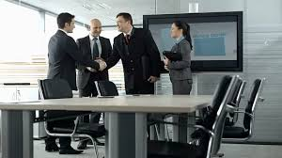
Learn from the Best
The fifth technique to observe when making small talk with customers is to learn from those who do it best. Make an effort to observe conversational champions such as talk show hosts, colleagues, or comedians. Consider what they say and how they say it. The best lesson is a good example.
Whether in a social or professional setting, small talk is extremely important. It can impress co-workers or bosses, or make you the life of the party. Improving your small talk skills by doing a few simple training exercises every day can make all the difference.
Back
Next

Slide 36
Small Talk Mastery Check
Small
Talk
Mastery
Mastery Check: Apply your knowledge by selecting the correct answer.
Question: Small talk accomplishes all of the following except:
Breaks the ice and puts others at ease.
Establishes a connection or defines a common denominator between two persons.
Is most effective when you focus on yourself and less on the other person.

Slide 37
Small Talk Mastery Check
Small
Talk
Mastery
Mastery Check Answer
Question: Small talk accomplishes all of the following except:
Small Talk accomplishes this, try again.
Breaks the ice and puts others at ease.
Select Another

Slide 38
Small Talk Mastery Check
Small
Talk
Mastery
Mastery Check Answer
Question: Small talk accomplishes all of the following except:
Small Talk accomplishes this, try again.
Establishes a connection or defines a common denominator between two persons.
Select Another

Slide 39
Small Talk Mastery Check
Small
Talk
Mastery
Mastery Check Answer
Question: Small talk accomplishes all of the following except:
Correct - small talk should be focused on your conversation partner, not yourself.
Is most effective when you focus on yourself and less on the other person.
Continue

Slide 40
Learning Resources
Small
Talk
Mastery
Back
Next

Slide 41
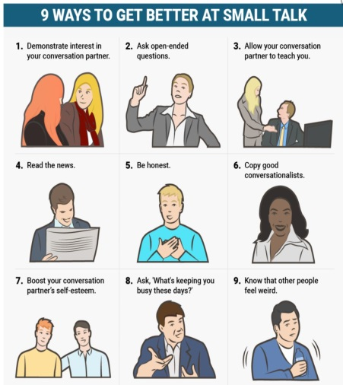
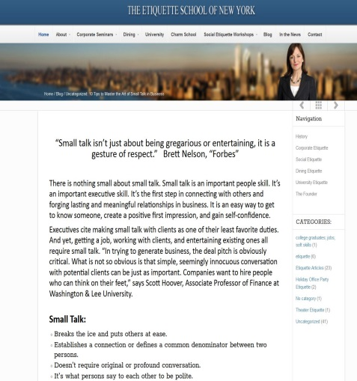
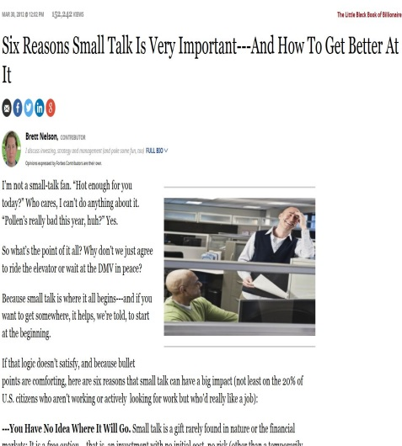
Learning Resources
Small
Talk
Mastery
Small talk is used to break the ice between people and form connections. Some people seem to be naturals at jumping in and making great conversation. Alas, be encouraged, if you are not one of these with the “gift of gab” do know that it is a skill that can be learned, practiced, and mastered. Click on the following resources to learn more about how to enhance your small talk skills.
Small Talk is Very Important
Back
Next

Slide 42
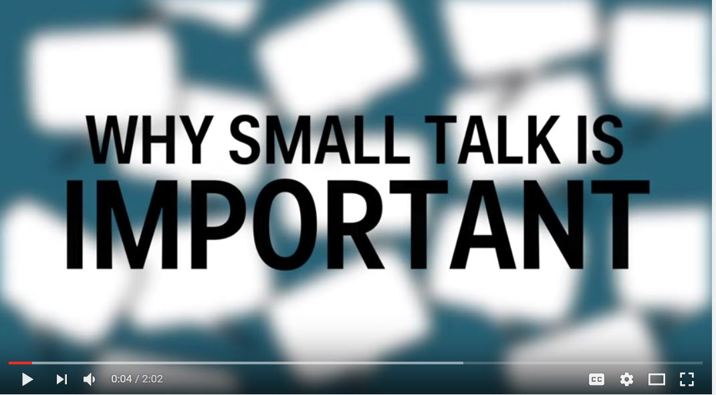
Learning Resources
Small
Talk
Mastery
Click on the following video to learn more about how to enhance your small talk skills.
Small Talk is Very Important
Back
Next

Slide 43
Small
Talk
Mastery
Great job!!
You have completed
Small Talk Mastery Training
Back
Home

